Slide 1

CENTER FOR YOGA - SRMIST
UNIT - 1
SESSION – 1 & 2
Fundamentals Of Yoga / Yoga For Physical Development

Slide 2
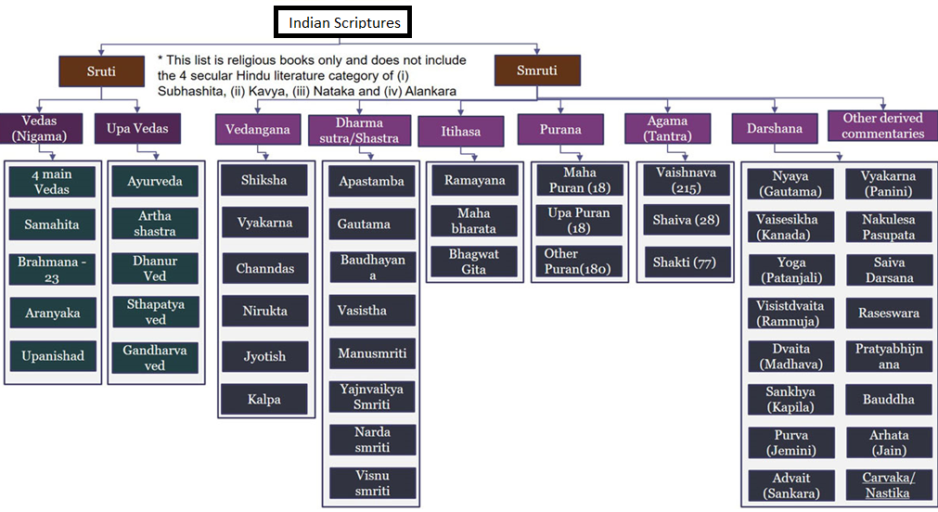
Where Yoga Stands.?

Slide 3
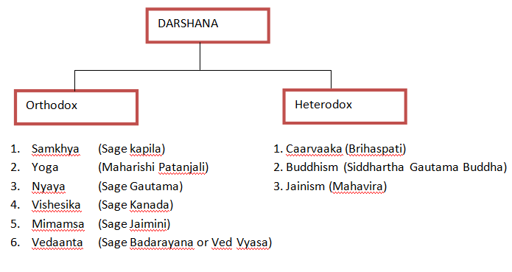
Darshana Classification

Slide 4
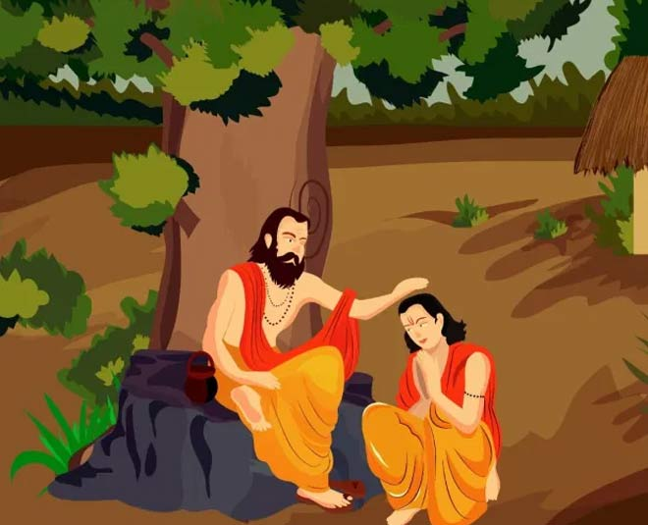
Importance Of Guru in Yoga
Who is a Guru.?
The syllable gu means darkness, the syllable ru means one who dispels them, Because of the power to dispel darkness, the guru is thus named.
A Guru will remove all doubts and ignorance and transform the vicious samskaras (mental impressions).
When you come to the Guru, seeking stops and blossoming begins.
The Guru is presence unlimited, vast, infinite and all-inclusive.
The presence of the Guru in one’s life brings fulfillment to all other relationships.
citraṃ vaṭatarormūle vṛddhāḥ śiṣyāḥ gururyuvā |
gurostu maunavyākhyānaṃ śiṣyās tu chinna saṃśayāḥ ‖
Wonderous indeed! Under the tree are the aged disciples around the youthful Guru. He taught them with silence, but the doubts of the disciples were all dispelled.
Yoga Journey must start in the presence of the Guru. Without the Guru, You will lose out on the path.
தெளிவு குருவின் திருமேனி காண்டல்
தெளிவு குருவின் திருநாமஞ் செப்பல்
தெளிவு குருவின் திருவார்த்தை கேட்டல்
தெளிவு குருவுரு சிந்தித்தல் தானே.
Clarity is seeing the holy Body of guru;
Clarity is saying the holy Name of guru;
Clarity is listening to the holy Words of guru;
Clarity is contemplating on the holy Form of guru.

Slide 5
Indian Heritage and Culture
Meaning and Definitions Of the Term Yoga
Yoga is usually defined as union: union between the limited self and the Divine Self. The aim of Yoga is not really to unite us with anything for we are already united. It is to help us realize our identity with the Divine Self, to make us know and tune into our intrinsic nature. There are many definitions of Yoga, which apply to all levels of existence and awareness. At the physical level, we need to harmonize the functions of different organs, muscles and nerves so that they do not hamper or oppose each other. Disharmony in various body parts and systems brings about inefficiency and lethargy or clumsiness. Moreover, it manifests in diseases in the body.
In this context we can define Yoga as physical harmony & health and mental balance & peace.
The Bhagwad Gita, a very widely known classical text on Yoga, gives various definitions of Yoga.
Yoga is equanimity of mind in success and failure.
Yoga is discretion in work.
Yoga is the remover of misery and destroyer of pain. Yoga is the supreme secret of life.
Yoga is serenity.
Patañjali, the author of the classical Yoga text, The Yoga Sutras, defines Yoga as, “complete control over patterns or modifications of the mind.” [Yogah cittavrtti Nirodhah (PYS I/2)]

Slide 6
Misconceptions About Yoga
For many the practice of yoga is restricted to asanas
Many consider yoga as an exercise and well being regimen of the hindus
Some people consider yoga as mere exercise[Where as it should never be mistaken for any other mode of exercise, which is operational only on a physical level]
Some people believe that yoga is not challenging enough and ranks low as a cardiovascular workout

Slide 7
History Of Yoga
Pre Vedic Period [ Harappa and Mohenjedaro]
Vedic Period [ 4 Vedas ]
Post Vedic Period [ Upanishads, Ramayana and Mahabharatha]
Pre Classical Period [ Yoga sutras - Ashtanga Yoga]
Classical Period [ Hatha Yoga Texts ]
Modern Period [ Swami Vivekananda, Ramana Maharishi, Sivananda, Krishnamacarya, Yogananda]

Slide 8
Objectives Of Yoga
Kaivalyam [Self Realisation and Actualization]
Mind Control
Body and Breath Control
Harmonious Living [Enhances the function of all body systems]
Helps oneself to come out of suffering [Therapy]

Slide 9
Woman and Yoga Practice
Women, who were allowed to study and practice Yoga during the Vedic period, were prevented from doing so, in the later years; the situation has however changed, with women practicing Yoga, everywhere for various reasons. Primarily they practice yoga for,
Keeping themselves Fit and in shape
Pregnancy Yoga for Normal Delivery
Post Pregnancy stress
Weight loss
Therapy Needs

Slide 10
Purpose Of Life
Dharma – Ethical and Moral Conducts
Artha – Earnings in proper way as guided by the dharma
Kama – Desires to be fulfilled in a proper way as guided by dharma
Moksham – The final purpose, Which happens if you follow the above 3 properly

Slide 11
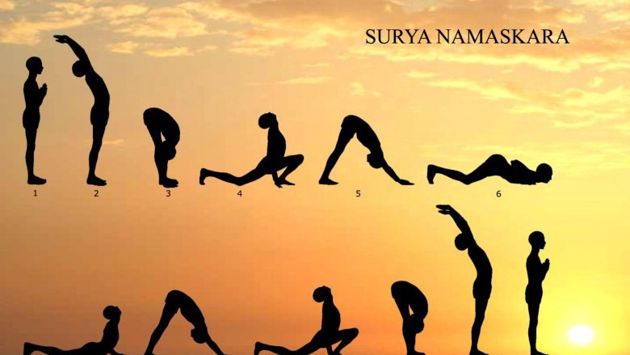
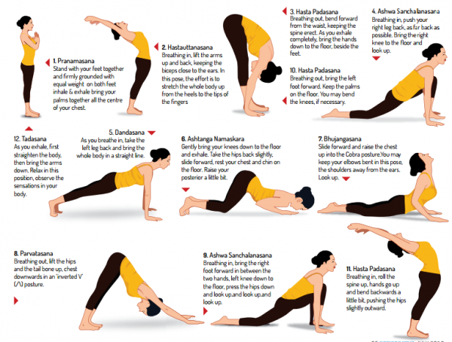
Body Structure and Maintenance
Variation - 1
Variation - 2

Slide 12
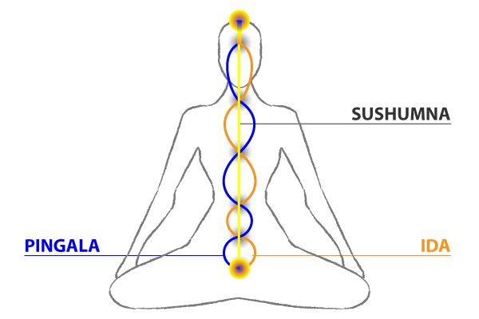
Yogic Anatomy
Now lets discuss how Yogis have seen the anatomy in their
deep meditative states. Lets understand few terminologies
before going into the subject.
Nadi’s: They are subtle energy channels.
There are 3 main Nadi’s they are Ida, Pingala and Sushumna
Prana: Energy that enliven us
Chakras: The Juncture of these 3 nadis are called Chakras

Slide 13
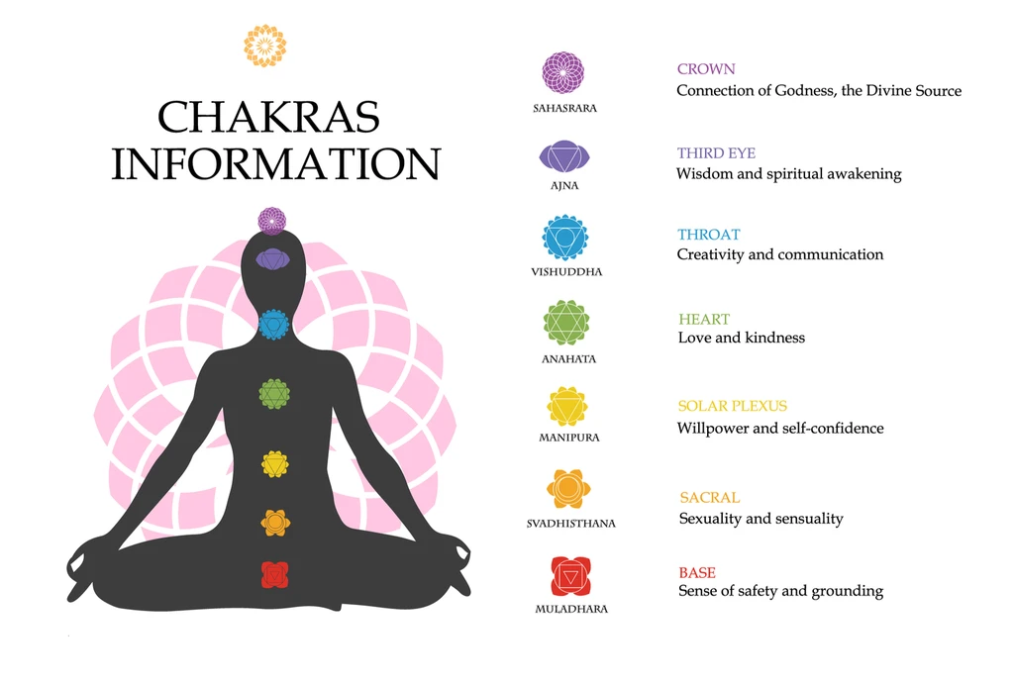
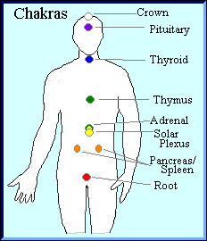
Yogic Anatomy Cotn..
The Seven Chakras,
Muladhara
Svadhistana
Manipura
Anahata
Visuddha
Ajna
Sahasra

Slide 14
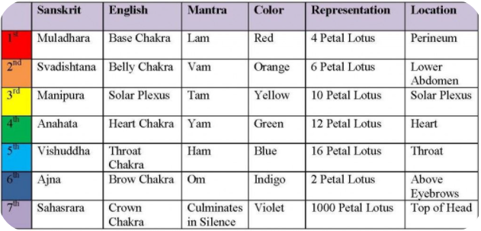
Yogic Anatomy Cotn..
Here is the consolidated table for easy memory

Slide 15
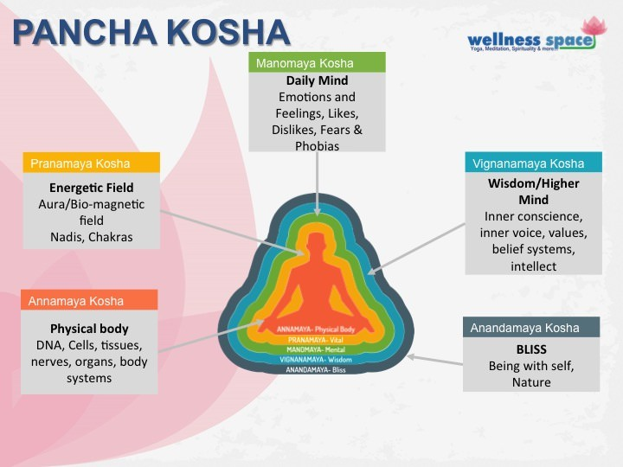
Pancha Koshas
The Understanding of the human anatomy is explained in yet another interesting way in Taittriya Upanishad. It calls it as Kosha’s or sheaths. Let’s Understand the human body with insights from Tattriya Upanishad.
1. Annamaya Kosha
2. Pranamaya Kosha
3. Manomaya Kosha
4. Vijnanamaya Kosha
5. Anandamaya Kosha

Slide 16
Human Anatomy [Scientific View]
Humans—and other complex multicellular organisms—have systems of organs that work together, carrying out processes that keep us alive.
The body has levels of organization that build on each other. Cells make up tissues, tissues make up organs, and organs make up systems.
The collection of various organs of the body is called a system. The human body is divided into different systems according to their function. They are:
1. Skeletal system – dealing with bones and joints of human body, Gives Shape.
2. Muscular system – dealing with Various muscles and their function, Protecting the Skeletal system
3. Respiratory system – dealing with organs responsible for breathing
4. Circulatory system – dealing with heart and the blood vessels
5. Digestive system – dealing with the organs and associated glands involved in the digestion for food
6. Urinary system – dealing with the organs involved in the excretion of wastes
7. Genital system – dealing with the organs of reproduction
8. Endocrine system – dealing with ductless glands and their functions.
9. Nervous system – dealing with brain, spinal cord and their structures responsible for all type of senses like touch, taste etc..

Slide 17

Yogic Creation of this Universe
Before Understanding the yogic view of creation of this universe, Lets understand the terminologies so that the process becomes easier.
Purusa - Spirit , Self, Consciousness, Atman, Soul - Its Characteristics are [Unchangeable, Ever Active, Aware, Birthless, Deathless, Cannot be Created or destroyed, Changeless substratum which witnesses all the changes]
Prakriti - Prakriti is the potency that brings about evolution and change in the empirical universe. It includes, Gunas, The 5 great elements, The organs of senses and action. [Ever Changing, Not Aware]
Gunas - Sattva [Illumination] , Rajas [Activity] and Tamas [Laziness]
How the creation Happens.?
The contact of these two is necessary for the purpose of creation. Evolution can take place through the activity of prakriti only when the energy of prakriti is conjoined with purusa although their natures are so different. In explaining this
contradiction, Samkhya employs the classic examples of the blind man and the lame man. The blind man and
the lame man co-operated with each other to escape a fire. The lame man climbed on the shoulders of the
blind man and directed him along the correct path. In this way both of them reached a safe and desired spot.
In much the same manner, the Conscious purusa and the unconscious prakriti cooperate in order to achieve
the objective of creation. This contact creates disturbance in the stability of the gunas of prakriti and evolution
starts. Prakriti needs purusa so that it may be seen, known and utilized and the purusa stands in need of
prakriti in order to experience and attain salvation by distinguishing between itself and the prakriti.

Slide 18
Understanding Mind
What is your understanding of Mind.? - Is it brain.?, Is it inside the body.?, Is there a way to see using MRI or CT Scan.? So where actually the Mind is.? – If we answer these questions, we may get a fair idea of what is called a Mind.
EX – The term “ORCA” or “Platypus” or ‘’Ambidexterity’’
Definition of Mind From Britanica - Mind, in the Western tradition, the complex of faculties involved in perceiving, remembering, considering, evaluating, and deciding. Mind is in some sense reflected in such occurrences as sensations, perceptions, emotions, memory, desires, various types of reasoning, motives, choices, traits of personality, and the unconscious. In Indian Context the mind is the “Psychic extension of life force”.
What according to Yoga is Mind.?
The Yoga Sastra uses the word “Citta” to represent the mind. It says the mind is identified my its activities. The activities it lists are,
Pramana – Right Understanding
Viparyaya - Wrong Understanding
Vikalpa - Imagination
Nidra - Deep sleep [Unconscious]
Smrthihi - Memory
From this understanding's we get to know there is something called mind and it is different from the brain.

Slide 19
Disease and Causes
There are various reasons that causes diseases in the body. We will see few important things so that precautionary measures can be taken to avoid suffering.
Natural Reasons:
Genetic Imprints [Hereditary]
Planetary Position
Natural Calamities and Climatic Changes
Artificial Reasons:
Food [Hitham Mitham Aharam – Appropriate food with right quantity]
Thought [Seek a way to avoid negative thoughts]
Deed [As you so, so you reap]
Factors To Be Limited:
Over eating [What Yoga says about this]
Work [Don't Over exert]
Sleep [Repair time]
Sexual Gratification [Within Limits]
Use of thoughts [Be aware of this process – Divert yourself if necessary]

Slide 20
END

